Slide 1
Plant Disease Classification

Slide 2

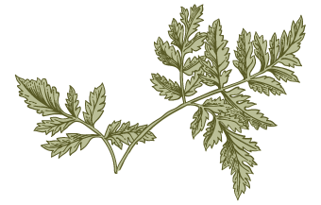
Outline
0
Abstract
Introduction
Motivation
Objectives and scope
System requirement
Preprocessing
Training and Testing Algorithm
Applications
Summary
Future Scope

Slide 3
Abstract
In the project, we used machine learning models for utilizing to detect plant diseases in the agriculture sector. Automatic plant disease detection, which recognizes indications of the illness as soon as they occur on plant leaves, is crucial in agricultural research for monitoring huge fields of crops. With some training samples from those two groups, the automatic classifier CNN will be employed for this method of categorization. Last but not least, the error during the outcome demonstrates that the employed network classifier offers less error during training and greater classification accuracy. Farmers engage with agricultural consultants to identify plant diseases.

Slide 4
Introduction
Automatic detection of diseases by just seeing the symptoms on the plant leaves makes it easier also machine vision to provide image-based automatic process control.
Image segmentation is grouping an image into different parts. This Thresholding process is an advanced color method This process is based on various features found in the image.
Genetic algorithm searches from a large sampling of the cost surface. A large number of variables can be processed and Gives a number of optimum solutions, different image segmentation results can be obtained.

Slide 5
Motivation
Farmers find it challenging to recognize a variety of plant illnesses.
Worldwide crop losses resulting from plant disease are estimated to be $60 billion annually.
Since it requires a lot of manual labor and time, typical tools and techniques are not very useful.
The obstacles will no longer be a barrier, though, with the aid of a disease-detecting system.

Slide 6
Objectives and Scopes
Objectives:
To identify the relationships between the disease-causing organisms and their host plants in relation to the ecosystem as a whole.
To put into practice a technique for illness prevention and offering management for lowering the losses/damages brought on by diseases.
to recognize numerous plant diseases.
Scope:
Avert plant diseases for farmers.
Assist the pesticide manufacturer in foreseeing new pesticide remedies

Slide 7
System Requirement
Hardware Requirements
Processor: Intel Core i3
RAM: 4 GB
Hard Disk: Minimum 500 GB
Software Requirements
Operating System: Windows 8 onwards
Programming Language: Python 3.8.
Browser: Google Chrome Hardware

Slide 8
About Dataset
The dataset collected from open source website “kaggle”.
The dataset contains 87k image samples of 14 crops.
The dataset consists of 38 classes corresponding to 38 leaf diseases of 14 crops.
The 38 classes are listed below:
Tomato___Late_blight', 'Tomato___healthy', 'Grape___healthy', 'Orange___Haunglongbing_(Citrus_greening)', 'Soybean___healthy', 'Squash___Powdery_mildew', 'Potato___healthy', 'Corn_(maize)___Northern_Leaf_Blight', 'Tomato___Early_blight', 'Tomato___Septoria_leaf_spot', 'Corn_(maize)___Cercospora_leaf_spot Gray_leaf_spot', 'Strawberry___Leaf_scorch', 'Peach___healthy', 'Apple___Apple_scab', 'Tomato___Tomato_Yellow_Leaf_Curl_Virus', 'Tomato___Bacterial_spot', 'Apple___Black_rot', 'Blueberry___healthy', 'Cherry_(including_sour)___Powdery_mildew', 'Peach___Bacterial_spot', 'Apple___Cedar_apple_rust', 'Tomato___Target_Spot', 'Pepper,_bell___healthy', 'Grape___Leaf_blight_(Isariopsis_Leaf_Spot)', 'Potato___Late_blight', 'Tomato___Tomato_mosaic_virus', 'Strawberry___healthy', 'Apple___healthy', 'Grape___Black_rot', 'Potato___Early_blight', 'Cherry_(including_sour)___healthy', 'Corn_(maize)___Common_rust_', 'Grape___Esca_(Black_Measles)', 'Raspberry___healthy', 'Tomato___Leaf_Mold', 'Tomato___Spider_mites Two-spotted_spider_mite', 'Pepper,_bell___Bacterial_spot', 'Corn_(maize)___healthy

Slide 9
Libraries and visualization dependencies
TensorFlow
Pickle
OpenCV
Pandas
Matplotlib
Transfer learning
CNN
Streamlit

Slide 10
Data Preprocessing
Image processing :
It is a method to perform some operations on an image, in order to get some useful information from it.
Steps involved in image processing are:
Image Acquisition
Image Enhancement
Image Restoration
Color Image Processing
Image Segmentation

Slide 11
Image Acquisition
Image acquisition is the first step in image processing. It involves retrieving the image from a source, usually a hardware-based source. OpenCV gives the flexibility to capture image directly from a pre-recorded video stream, camera input feed, or a directory path.
Example:
img = cv2.imread('/content/new plant diseases dataset(augmented)/data/train/Apple___Apple_scab/00075aa8-d81a-4184-8541-b692b78d398a___FREC_Scab 3335.JPG')

Slide 12
Image Enhancement
Image enhancement is the process of adjusting digital images so that the results are more suitable for display or further image analysis. For example, you can remove noise, sharpen, or brighten an image, making it easier to identify key features.
final_mask = mask + disease_mask
final_result = cv2.bitwise_and(img, img, mask=final_mask)
plt.figure(figsize=(10,10))
plt.subplot(1, 2, 1)
plt.imshow(final_mask, cmap="gray")
plt.subplot(1, 2, 2)
plt.imshow(final_result)
plt.show()

Slide 13
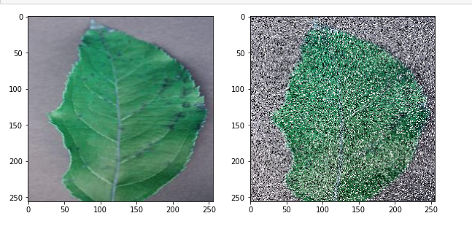
Image Restoration
Image restoration is the process of recovering an image from degraded version –usually a blurred and noisy image.

Slide 14
Color Image processing
In color image processing, an abstract mathematical model known as color space is used to characterize the colors in terms of intensity values. This color space uses a three-dimensional coordinate system. RGB is the default color space.
# lets change the color from BGR to RGB
img = cv2.imread('/content/new plant diseases dataset(augmented)/data/train/Apple___healthy/03d420e7-42a1-41d8-9600-16d577043c64___RS_HL 5738.JPG')
plt.subplot(1,2,1)
plt.imshow(img)
plt.subplot(1, 2, 2)
img = cv2.cvtColor(img, cv2.COLOR_BGR2RGB)
plt.imshow(img)
plt.show()
hsv_img = cv2.cvtColor(img, cv2.COLOR_RGB2HSV)
gray_image = cv2.cvtColor(img,cv2.COLOR_BGR2GRAY)
sketch_image=cv2.divide(gray_image,inverted_image, scale=256.0)
pencil_sketch=cv2.cvtColor(sketch_image, cv2.COLOR_BGR2RGB)

Slide 15
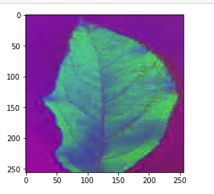
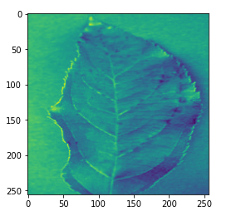
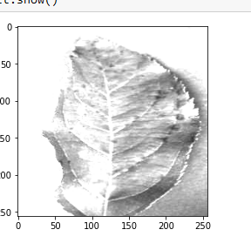
Color Image processing Contd.
RGB2HSV:
RGB2GRAY:
RBG2SKETCH

Slide 16
Image Segmentation
Image segmentation is a method in which a digital image is broken down into various subgroups called Image segments which helps in reducing the complexity of the image to make further processing or analysis of the image simpler.
Types of Image Segmentation:
Image Segmentation using edge detection
Image Segmentation using K means
Image Segmentation using Contour Detection
Image Segmentation using Color Masking

Slide 17
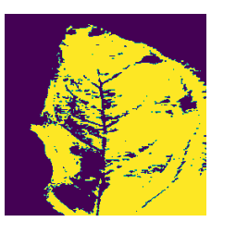
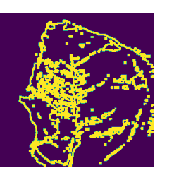
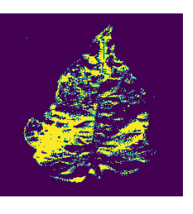
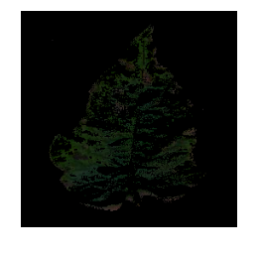
Image Segmentation Contd.

Slide 18
Training and Testing Algorithm
Step 1: Start
Step 2: Prepare Dataset (healthy/Unhealthy)
Step 3: Preprocessing – Normalization ( size of 64 * 64 )
Step 4: Train CNN
Step 5: Real Image from camera/pc
Step 6: Preprocessing (size = 64*64)
Step 7: Test Network

Slide 19
Training and Testing Algorithm
Step 8: if the probability of healthy > probability of unhealthy
Display Healthy Image
otherwise
Display an Unhealthy image
Step 9: Go to Step 4
Step 10: End

Slide 20
Applications
Image Recognition:-. Image rearrangement in a machine-learning environment Software's capacity to recognize things, locations, people, text, and actions in images is known as machine vision.
Classification: It offers a precision of roughly 93% for the accurate and automatic diagnosis of leaf diseases.
Prediction:- The camera and app that make expert forecasts.
Extraction:- Techniques for extracting medicinal herbs The separation of the plant's medicinally effective parts is referred to as extraction.
Prediction of plant diseases and advice on fertilization

Slide 21
Summary
Describe a deep convolutional neural network model to identify plant foliar diseases.
80,000+ photos were used for training and validation.
shown that the model can be used to predict a wide range of plant disease types..
The suggested method might be adopted in the future by including more services like neighboring public stores and a pesticide price list. open market nearby, among other things.
Also, the suggested system might be accessible via an application.
The given system uses resizing, thresholding, and Gaussian filtering for image preprocessing. To segment the leaf area' Then finally CNN classification technique is used to detect the type of plant disease.

Slide 22
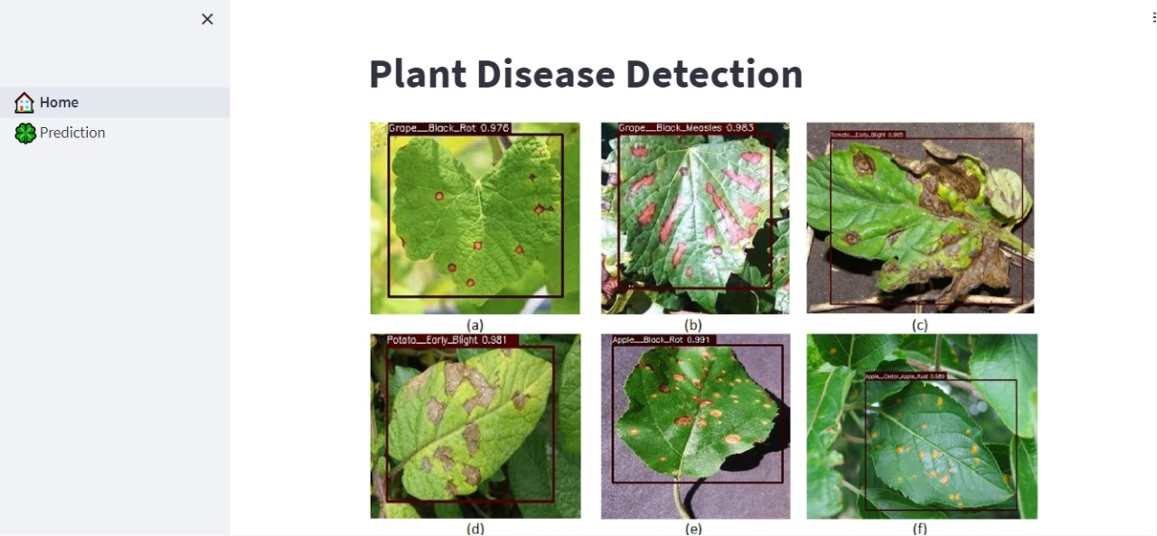

Slide 23
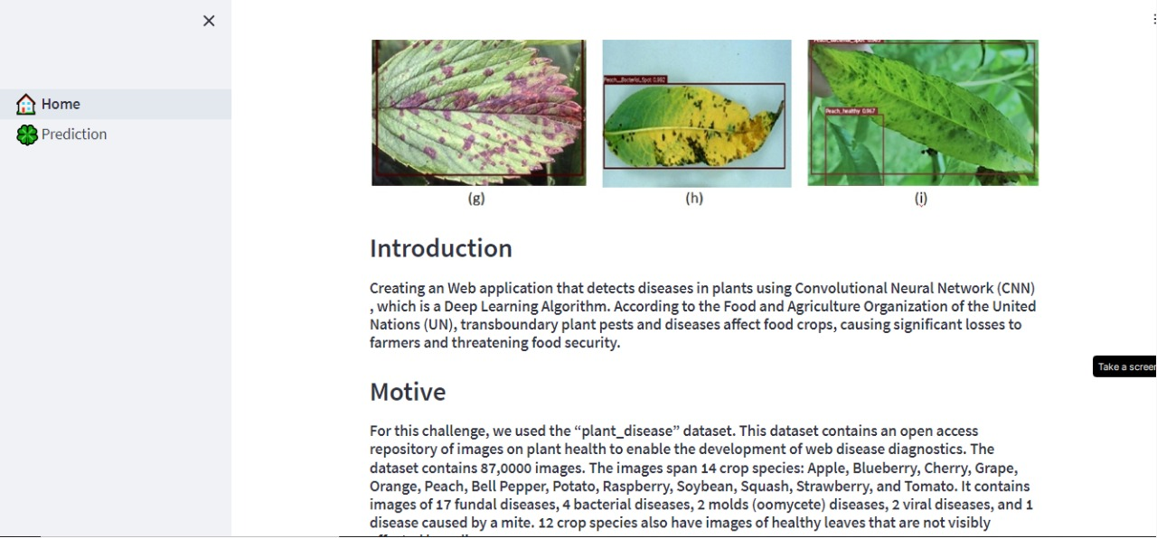

Slide 24
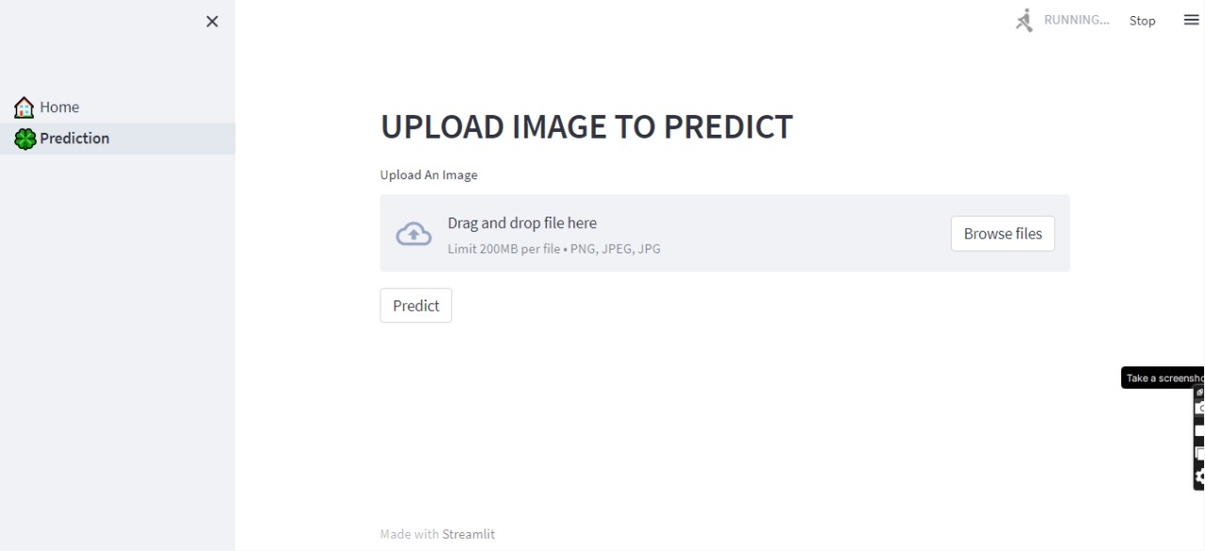

Slide 25
Future Scope
Because disease forecasting is done early on, the necessary precautions can be taken to prevent crop loss.
As soon as the disease crops up on the leaf, our project can identify it.
Developing and training a CNN model from scratch is a difficult task. This model can also be used to detect and classify other plant diseases by simply training it with the appropriate datasets.

Slide 26
References
https://www.kaggle.com/
https://www.analyticsvidhya.com/
https://towardsdatascience.com/
https://www.geeksforgeeks.org/
https://www.tensorflow.org/
https://keras.io/
https://docs.streamlit.io/

Slide 27
Thank you
By -
Sai Chandu Sunkara
Farhad Ahamed Biswas
Abdul Azad
Ankit Kumar Singh
Ambika Nayak

